Slide 1
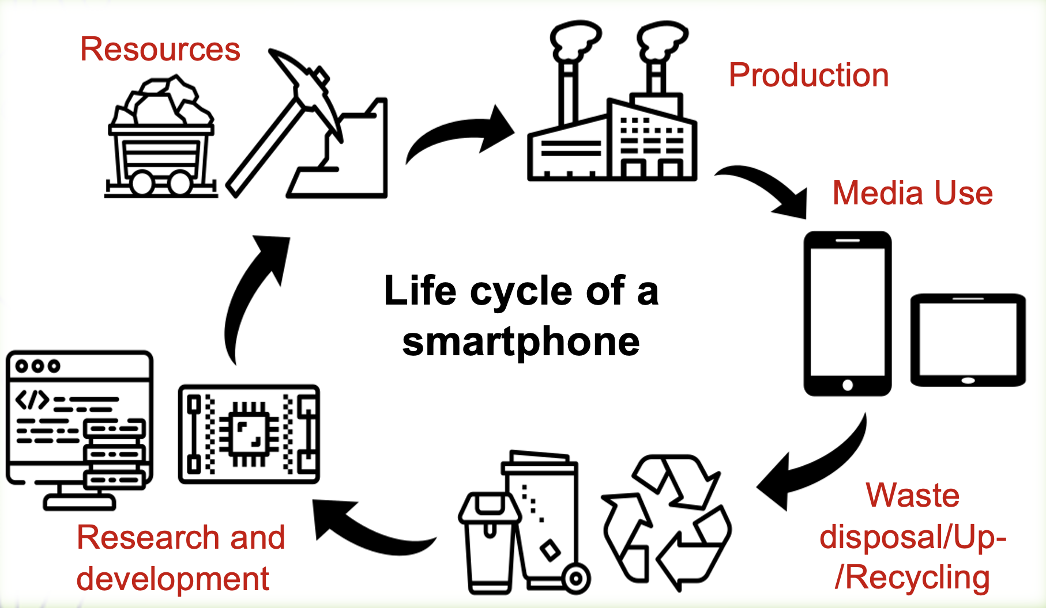
funded by:
Öha!
ÖHA! Digital media literacy and environmental protection
Martin Sankofi - Petra Szucsich
Pädagogische Hochschule Wien

Slide 2
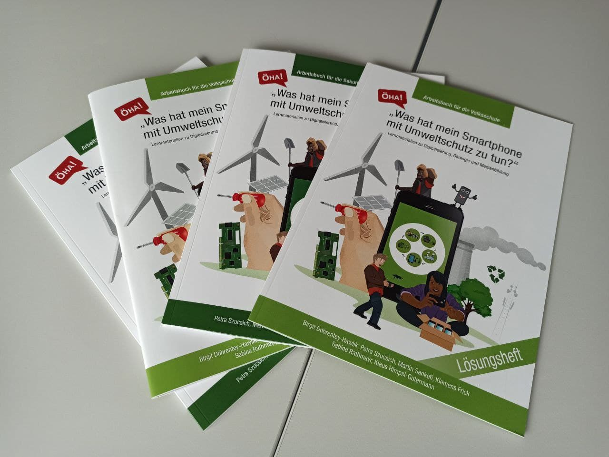
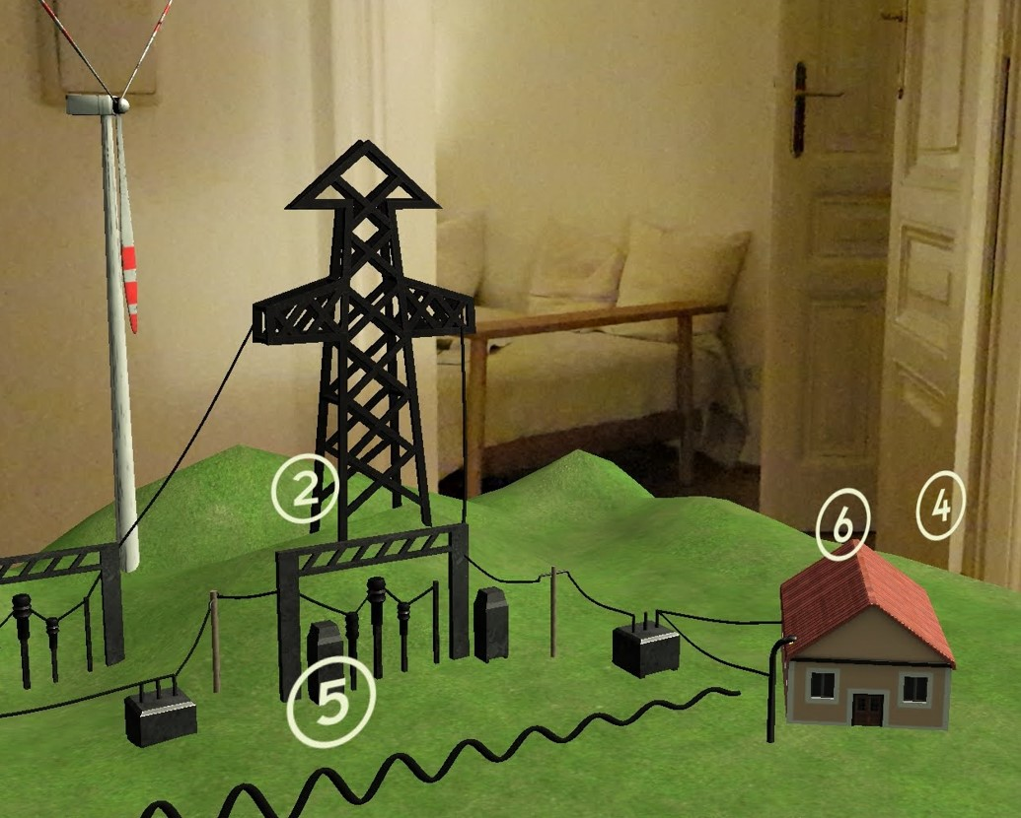
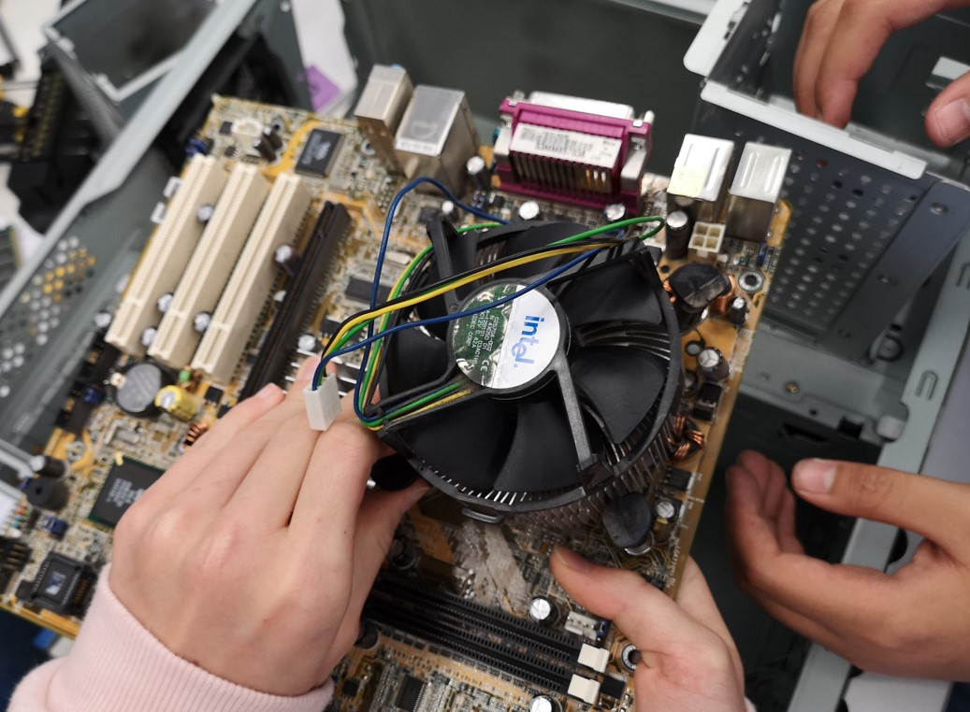
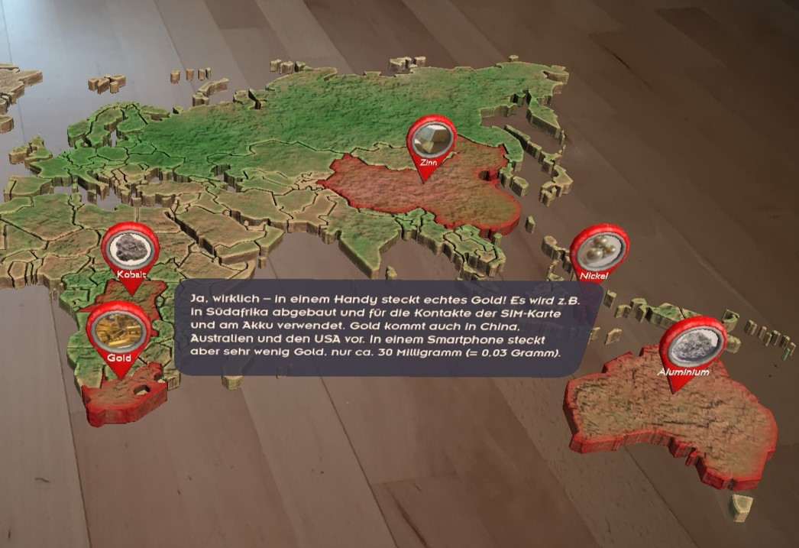
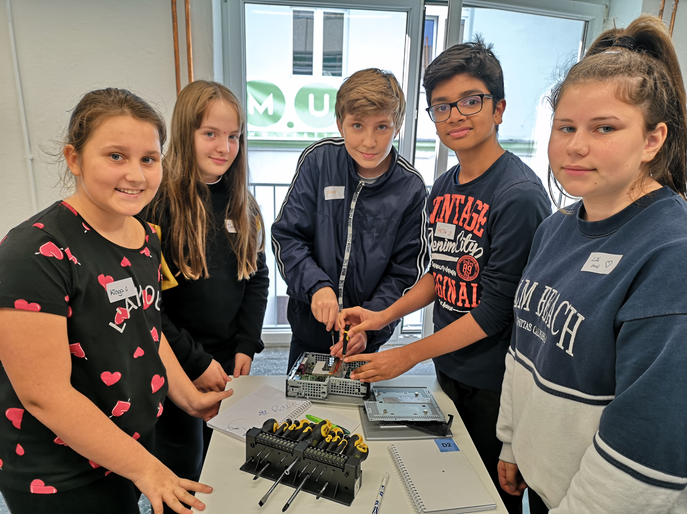
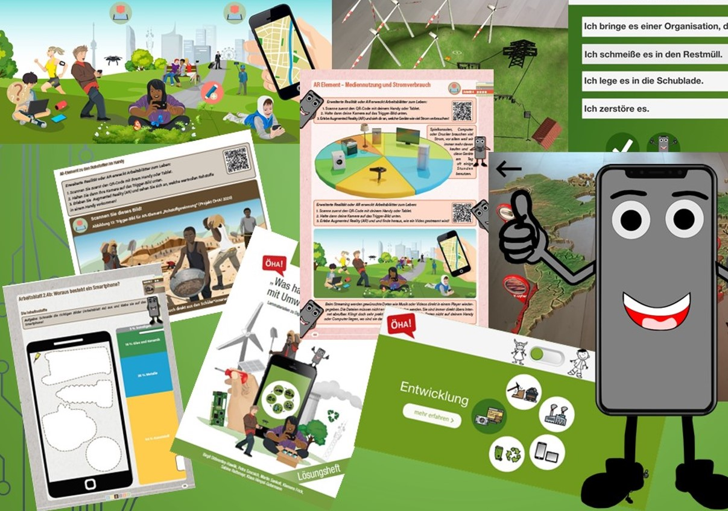
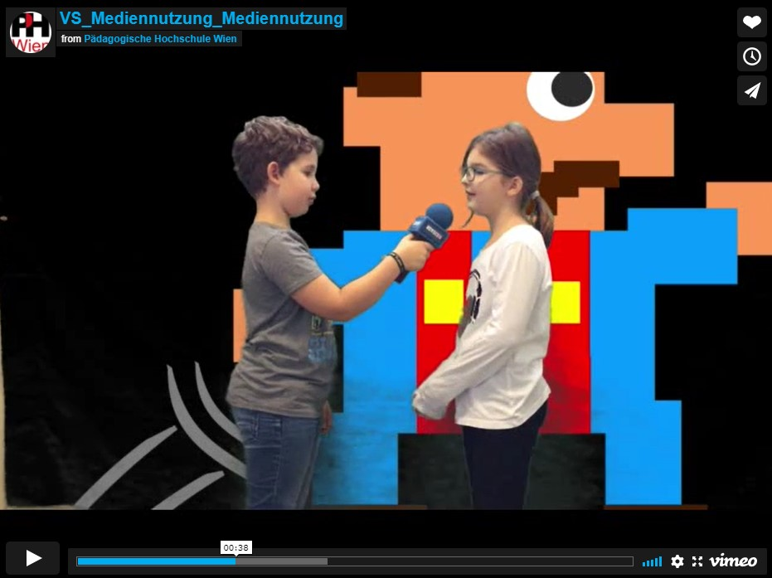
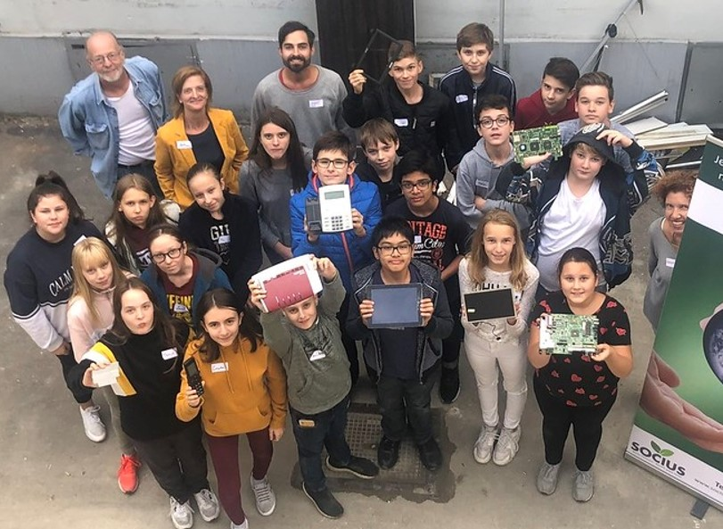
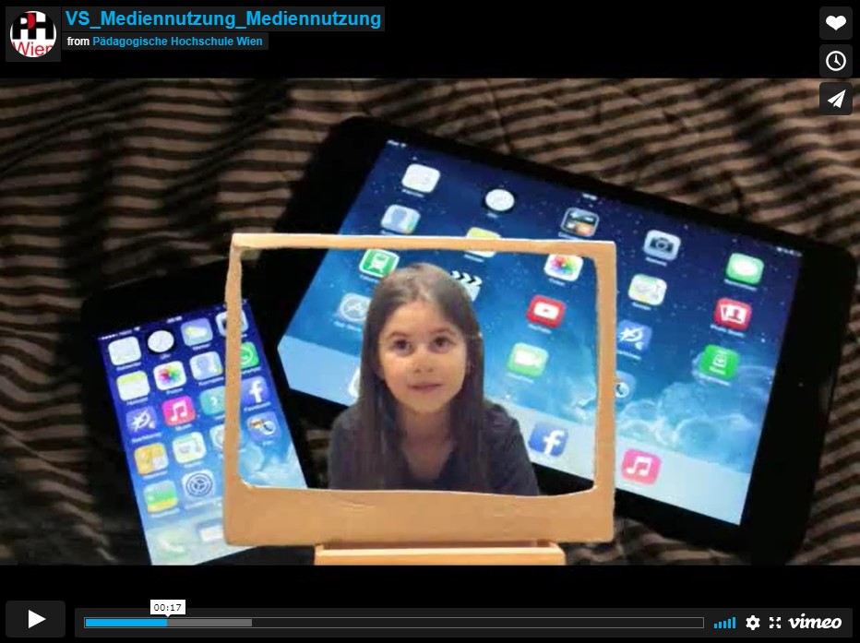
Enablers & success factors
cooperation with schools and teachers
cooperation with organizations beyond the school context
multimedia learning & teaching materials
oeha.phwien.ac.at
Notes:
Nina

Slide 3
one thing we would do differently?
Involving the public
Citizen Science approach
Pop-up exhibition
Re-use and Recycle of learning materials
citizen science approach proved difficult during the pandemic

Slide 4
Öha!
Kontakt
Mag. Petra Szucsich, MSc - E-Mail: petra.szucsich@phwien.ac.at
Mag. Martin Sankofi, MSc - E-Mail: martin.sankofi@phwien.ac.at
Notes:
Nina, KHG

