Slide 1










Educational Knowledge Transfer
Improving Educational innovation, competitiveness and quality of higher education through collaboration between University and Companies
1ª Kick-off meeting
21-22/01/2020
Santiago de Compostela

Slide 2
EKT Project relevance
  1.1. Aims and objectives
  1.2. Strategic triangle
  1.3. Cooperation dynamics between ICT companies
  1.4. High component of educational and technological innovation
  1.5. Contexts and target groups
EKT Methodology and work structure
  2.1. Work packages
  2.2. Intellectual Outputs
Schedule and work sequence

Slide 3
EKT Project relevance: aims and objectives
1. To improve the quality of Initial Teacher Education and support during in-school teaching practice (in-school placement) which constitutes one of its essential components
2. Developìng e-learning methodologies and solutions that:
promote dynamics of coordinated work between the university and non-university teachers who supervise and accompany the student during the internship period.
allow the individualized follow-up of students in practice and their continued attention.
encourage self-learning and reflective thinking that the future teacher must perform during the period of teaching practice
Notes:
Although the dimensions of the project are multiple and are projected on education, the technology industry, the dynamics of scientific knowledge production and knowledge transfer, EKT pursues two main objectives:
1 To improve the quality of Initial Teacher Education and support during in-school teaching practice (in-school placement) which constitutes one of its essential components
and
2 to develop e-learning methodologies and solutions that:
promote dynamics of coordinated work between the university and non-university teachers who supervise and accompany the student during the internship period.
allow the individualized follow-up of students in practice and their continued attention.
encourage self-learning and reflective thinking that the future teacher must perform during the period of teaching practice
the five university institutions belonging to the consortium have direct responsibility for the ITE in our countries and share the challenge of improving the training of future teachers in our countries and in Europe
All international trends and scientific literature reinforce the importance of in-service placements and even the need for the first years of the profession (a period of initiation to the profession) to become a high quality training experience.
We believe that the results of this project can be useful and can be transferred not only to the ITE but to the new systems of access to the teaching profession that can be implemented in Europe in the coming years

Slide 4
EKT Project relevance: Strategic triangle
Educational centres
(Schools and teachers)
Technology-based companies/institutions
Universities and researchers
Notes:
To do this, we rely on a strategic triangle configured by educational centres (schools and teachers), universities (Faculties of Education and researchers) and technology-based companies/institutions (specifically those that offer services and e-learning resources).

Slide 5
EKT Project relevance: cooperation dynamics
Educational Research
Teaching Innovation
Technological development
Knowledge development
Notes:
We propose to work in an articulated way from these three contexts to establish a dynamics of knowledge development based on teaching innovation, educational research and technological development.

Slide 6
EKT Project relevance: educational and technological innovation
Educational Technological
Innovative in-school placement methodology
Effective and flexible elearning environment
Adapted to in-schools placement needs
Smart technological framework
Mobile app
Dynamics coordinated work
The individualized follow-up of students
The reflexive self-learning process
Integration of different tools & contents & functionalities
integration of standars, languajes and infraestructures
Interoperability (standar X-API)
Scalable
Notes:
Our project is characterized by a high component of educational and technological innovation. A response to the needs for improvement of the ITE that is characterized by two perfectly aligned derivative products
an innovative in-school placement methodology and a smart technological framework that make possible and enhance the coordinated work, the individualized follow-up of students and the self-learning process required by in-school practices

Slide 7
EKT Project relevance: contexts and target groups
Contexts | Target groups
Faculties and Institutes of Educational Sciences | University lecturers and researchers of Education Sciences University Students (prospective teachers) Official studies of Initial Teacher Education (ITE) in Kindergarten, Primary and Secondary Education
Schools where prospective teachers do their internships (which collaborate with Faculties and institutes on in-school placements) | School teachers
Notes:
The project is contextualized in the Faculties and Institutes of Educational Sciences and in particular in the official studies of Initial Teacher Education (ITE) in kindergarten, Primary and Secondary Education.
The results of the project will therefore benefit ITE students (prospective teachers), university lecturers and teachers in schools who receive and accompany them during in-school placements.

Slide 8
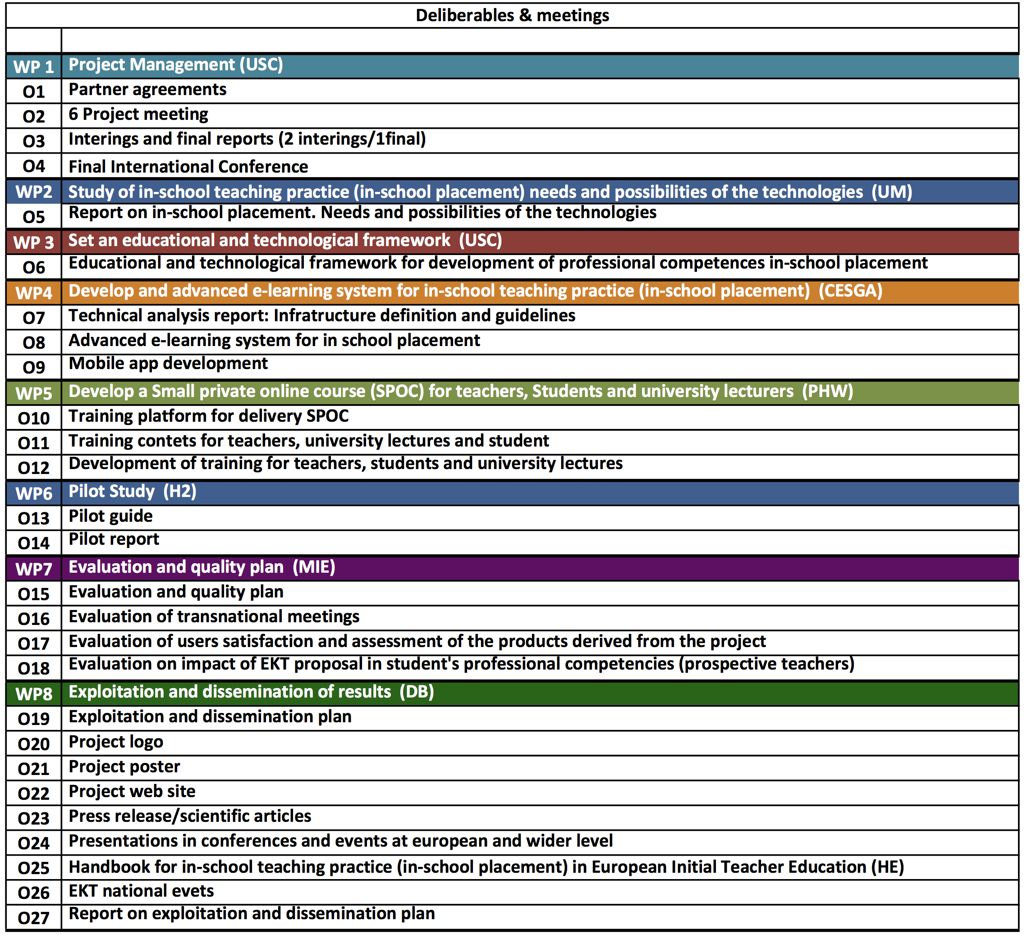
EKT: Methodology and work structure
Notes:
The project is designed according to a sequence organized in 8 interrelated WPs and an intense work guided by the progressive elaboration of 27 outputs
As you know 3 of the WP are transversal and extend throughout the project: 1, 7 and 8: management, Evaluation and quality plan and exploitation and dissemination coordinated by USC, Marino and DIe Berater respectively
and the other 5 WPs are the driving force behind the proposal: 2,3,4,5,6 status and needs, proposal development and piloting for improvement. The evaluation of the proposal and the pilot included in wp 7 will be essential to ensure the success and outcome of the project
It is important that we all share the same vision about the project and the expected results, so I will stop briefly at each WP with the outputs that we have to produce, in which we all contribute but that must be properly energized by the leaders of each WP to ensure their realization in time and quality.

Slide 9
WP 1: Management (USC)
Aims/tasks | WP Lead | Deliverable Nº/ Title |  | Deadline | Language
To implement project work plan and ensure partners commitment Monitor overall project progress Financial balance Produce together with partners interim and final reports Implement a good communication before, during and after project life with partners | USC | O.1 | Partner agreements | 15/12/2019 | English
 |  | O.2 | Project meetings | Dec 2019 ES Jul 2020 UK Dec 2020 AT Jul 2021 IE Dec 2021 PT Jul 2022 ES | English
 |  | O.3 | 2 Interim and 1 final reports | 1ª Interim 15/07/2020 (M1 to M9) 2º Interim 30/04/2021 (M10 to M18) 3º Interim 30/01/2022 (M19 to M27) Final Report 31/10/2022 (M28 to M36) | English
 |  | O.4 | Final International Conference | July 2022 ES | English
Notes:
As coordinators we have the responsibility:
To implement the project work plan and ensure partners commitment
To Monitor overall project progress
To Control the financial balance
To Produce together with partners interim and final reports
To implement a good communication before, during and after project life with partners
In this WP we will produce 4 outputs:
1) The partner agreements that are already in place. The transfer of the first payment will be made immediately
2) 6 Project meetings with the help of the hosts. They will take place in the months of December and May
3) 2 Interim and 1 final reports that will help us prepare the reports for the agency and that are directly linked to the release of project funds
4) The Final International Conference which will also take place in Santiago at the end of the project.

Slide 10
WP 2: Study of in-school placement needs and possibilities of the technologies (UM))
Aims/tasks | WP Lead | Deliverable No / Title |  | Deadline | Language
Analyse of characteristics and methodological proposals for in-school placement that are being developed in initial teacher education at European universities. Definition of needs for improvement in-school placement in of initial teacher education. Analyse of e-learning resources and services developed by e-learning companies and technological partners members of the EKT Consortium. Utilities, functionalities, educational possibilities and requirements for their articulation / integration. Study of in-school placement needs and possibilities of the technologies translation to the different languages (SP, EN, GE, PT). | UM | O.5 | Report on in-school placement. Needs and possibilities of the technologies | 31/03/2020 | English
Notes:
In WP2 coordinated by Minho University we will carry out a Study of in-school placement needs and possibilities of the technologies in order to
Analyse of characteristics and methodological proposals for in-school placement that are being developed in initial teacher education at European universities. How are they organised and developed in each country?
Define of needs for improvement in-school placement of initial teacher education. how to improve them? With special attention to
Dynamics coordinated work between university and non-university teachers who supervise and accompany the student during the internship period.
The individualized follow-up of students in practice and their continued attention.
The reflect self-learning process that the prospective teacher must perform during the period of in-school teaching practice.
Analyse of e-learning resources and services developed by technological partners members of the EKT Consortium
Study of in-school placement needs and possibilities of the technologies translation to the different languages (SP, EN, GE, PT).
As you see we need to develop Output 5 quickly so we will work today in groups to get it up and running and get out of the KO with the strategy, tasks and dates defined with the WP UM leader

Slide 11
WP 3: Set an Educational and Technological Framework (USC)
Aims/tasks | WP Lead | Deliverable No / Title |  | Deadline | Language
Design an innovative methodological proposal for the improvement of student teacher support and development during in-school teaching practice. Define the guidelines and specifications for the design of the EKT advanced e-learning system for students undertaking in-school teaching practice. Develop the Educational and Technological framework | USC | O.6 | Educational and technological framework for development of professional competences in-school placement | 31/07/2020 (Beta version) & 15/12/2021 (final version) | English
Notes:
In the WP3 coordinated by the University of Santiago we will define based on the previous study on the educational and technological framework that will guide the development of the advanced elearning system. This framework, as well as the technological system, will be fed back from the pilot and will be readjusted to give rise to a final version tested and modified with the contributions of the evaluation (WP 7)
The educational and technological framework It will have two components:
i) A complete methodological design for the development of in-school teaching practice in schools that allows to the identified improvement needs and improving quality in terms of interaction, collaboration, self-learning and reflective thinking
ii) A set of the guidelines and specifications for the design of the EKT advanced e-learning system for in-school teaching practice.

Slide 12
WP 4: Develop and advanced e-learning system for in-school placement (CESGA)
)
Aims/tasks | WP Lead | Deliverable No / Title |  | Deadline | Language
Analysis of implications from WP3 to WP4: features, functionalities, tools needed, tools & expertise available in the partnership. Adjustment of WP4 calendar for products development. Exchanging X-API Data. Guidelines and integration Development of integration in LMS, eportfolio, etc. Big Data / Cloud Infrastructure suitability for project development Mobile app development Beta version of e-learning system, including reporting dashboard integration, communication between system elements Final version of e-learning system. | CESGA | O.7 | Technical analysis report: Infratructure definition and guidelines. | 15/05/2020 | English
 |  | O.8 | Advanced e-learning system for in school placement | 30/11/2020 (Beta version) & 28/02/2022 (final version) | English Spanish Portuguese
 |  | O.9 | Mobile app development | 30/11/2020 (Beta version) & 28/02/2022 (final version) | English Spanish Portuguese
Notes:
WP 4 led by CESGA is the most complex one since it involves a complex technological development due to the need to integrate different technologies and services and make them interoperable. Its realization will give rise to three deliverables:
Output 7 Technical analysis report: Infratructure definition and guidelines.
Output 8 Advanced e-learning system for in school placement
Output 9 Mobile app development
Like the framework, the advanced e-learning system for in-school placement will have two versions, a pre-pilot beta and a final one that will incorporate the contributions derived from the evaluation carried out during the pilot by our colleagues from MIE and PU

Slide 13
WP 5: Develop a online course (SPOC) for teachers (School tutors), Students (prospective teachers) and university lecturers (tutors) (PHW)
Aims/tasks | WP Lead | Deliverable No / Title |  | Deadline | Language
Selection, update of the Training platform to the requirements of the course and integration in the EKT advanced e-learning system for in-school teaching practice. Design of the training proposal: contents, methodology, learning activities and evaluation proposal Design of digital content and implementation of the Training platform. Development of SPOC for school teachers, Students to be teachers and university lecturers | PHW | O.10 | Training platform for delivery SPOC | 30/09/2020 | English Spanish Portuguese
 |  | O.11 | Training contents for school tutor, university tutor and student (prospective teacher). | 30/09/2020 | English Spanish Portuguese German
 |  | O.12 | Development of training of school tutors, university tutors, and student prospective teachers) | 31/10/2020 | English Spanish Portuguese German
Notes:
The next phase involves training in the methodology and technological system of the participants in the pilot which as you know have three profiles: university lecturers, school teachers, and prospective teachers. It will be led by PHW.
Its realization will lead to three deliverables:
Training platform for delivery SPOC (linked to the technological system)
Training contents for school tutor, university tutor and student (prospective teacher).
Development of training of school tutors, university tutors, and student prospective teachers)
For this purpose, the participants in the pilot program (WP 6) must be selected beforehand.

Slide 14
WP 6: Pilot Study (H2 Learning LTD)
Aims/tasks | WP Lead | Deliverable No / Title |  | Deadline | Language
Defining, carrying and implement the piloting Agreement on resources, methodology and organizational issues Pilot the methodological proposal for school practices and the EKT advanced elearning system (BETA version) in host schools Piloting report Piloting assessment on impact in student (prospective teachers) profesional competences development and on in-school placements experience (collaboration, comunication, selflearning, reflection). Pretest and posttest of profesional competences (WP7) | H2 | O.13 | Pilot guide | 01/09/2020 | English Spanish Portuguese German
 |  | O.14 | Pilot report | 30/04/2022 | English
Notes:
After WP5 we would be ready to carry out the pilot in the 5 countries. It will be led by H2 and its realization will lead to two deliverables:
O13 Pilot guide
O14 Pilot report (Detailed description of the process start-up and pilot characteristics in each country)
WP 6 has an important complexity due to the difficulties of fitting in, taking into account the different time periods and organizational characteristics of in-school placements in each institution/country
It will take place during regular internships at our Faculties/Institutes of Education
Will require work in all 5 pilot countries is pt at ei and uk
In parallel to the implementation of the pilot, the necessary data will be collected from WP 7 for the evaluation of the impact of the advanced e-learning system for in-school placement. Our colleagues from MIE-PU will have to design the evaluation of the pilot.

Slide 15
WP 7: Evaluation and Quality Plan (MIE & PU)
Aims/tasks | WP Lead | Deliverable No / Title |  | Deadline | Language
Overall project process evaluation. Conducting evaluation based on evaluation plan (e.g. project management, evaluation of meetings- meeting minutes- work packages, cooperation): preparation of evaluation sheets for project meetings, interpreting the results and giving feed-back to the partners. Evaluation of the outputs. Evidence-gathering strategies and instruments will be implemented to evaluate the following products derived from the project | MIE-PU | O.15 | Evaluation and quality plan | 31/01/2020 | English
 |  | O.16 | Evaluation of transnational meetings | One for each meeting (6). Before meetings | English
 |  | O.17 | Evaluation of users satisfaction and assessment of the products derived from the project. | 01/03/2022 | English
 |  | O.18 | Evaluation of impact on EKT proposal in student's professional competencies (prospective teachers) | 31/05/2022 | English
Notes:
The WP7 led by MIE-PU is key to the project since the quality of the main products derived from the project depends largely on it:
framework ,
elearning System for in-school practices,
Mobile app,
Trainning platform and contents for delivery SPOC,
pilot guide and pilot results
The project design includes different indicators that can guide the design of evaluation and quality plan. This WP will result in 4 deliverables that will be key to the final evaluation of the project:
Evaluation and quality plan
Evaluation of transnational meetings
Evaluation of users satisfaction and assessment of the products derived from the project.
Evaluation of impact on EKT proposal in student's professional competencies (prospective teachers)
The project design includes different indicators that can guide the design of evaluation and quality plan. This WP will result in 4 deliverables that will be key to the final evaluation of the project:
Evaluation and quality plan
Evaluation of transnational meetings
Evaluation of users satisfaction and assessment of the products derived from the project.
Evaluation of impact on EKT proposal in student's professional competencies (prospective teachers)

Slide 16
WP 8: Exploitation and Dissemination of results (DB)
Aims/tasks | WP Lead | Deliverable No / Title |  | Deadline | Language
1. Dissemination To provide visibility to the project at national and European levels. Implement awareness-raising resources to reach potential users or beneficiaries of the project. Provide the project with a brand image for all the materials produced. 2. Exploitation Ensure sustainability and multiplication of the results. Communicate and lessons learnt to responsible Policy Makers and practitioners to prompt them to introduce changes in the education systems/curricula Transfer the best practices to other countries, universities, companies, Schools, Ministries of Education. | DIE BERATER | O.19 | Exploitation and Dissemination plan | 31/01/2020 | English
 |  | O.20 | Project logo | 15/12/2019 | English
 |  | O.21 | Project poster | 01/03/2020 | All languag.
 |  | O.22 | Project web site | 15/01/2020 | All languag.
 |  | O.23 | Press release/scientific articles | From Nov 2019 to OCT 2022 | All languag.
 |  | O.24 | Presentations in conferences and events at european and wider level | From JAN 2020 to OCT 2022 | All languag.
 |  | O.25 | Handbook for in-school placement in European ITE HE degrees | 01/06/2022 | All languag.
 |  | O.26 | EKT national events | 30/10/2022 | English
 |  | O.27 | Report on exploitation and dissemination plan | From SEPT 2022 to OCT 2022 | English
Notes:
Last but not least, taking into account that dissemination is one of the key elements of the erasmus plus programme and that it determines to a large extent the final evaluation results of the projects, the WP8 led by DieBerater has two objectives:
the dissemination and visibility of the project at national and European level by all possible ways and means
The transfer of results and their exploitation after the project is completed
This WP will result in 9 deliverables: two of them we have to work on as soon as possible: logo, web so that we can be visible as quickly as possible.
O19 Exploitation and Dissemination plan
O20 Project logo
O21 Project poster
O22 Project web site
O23 Press release/scientific articles
O24 Presentations in conferences and events at european and wider level
O25 Handbook for in-school placement in European ITE HE degrees
O26 EKT national events
O27 Report on exploitation and dissemination plan

Slide 17
EKT: Methodology and Work Estructure (Partners involved)
Notes:
One of the elements of project improvement suggested by the evaluators was that we should justify the adequacy of all partners and their input into all project activities. That is to say, a real university-business collaboration dynamic.
We differentiated in the proposal and it was materialized in the distribution of the budget (project implementation) 4 types of participations.
Leader
Special contributions
Feedback
Contribution
imply different levels of responsibility in the WPs but guarantee a real dynamic of knowledge transfer.
We must take this into account when making timesheets and progress reports. We will talk about it tomorrow

Slide 18
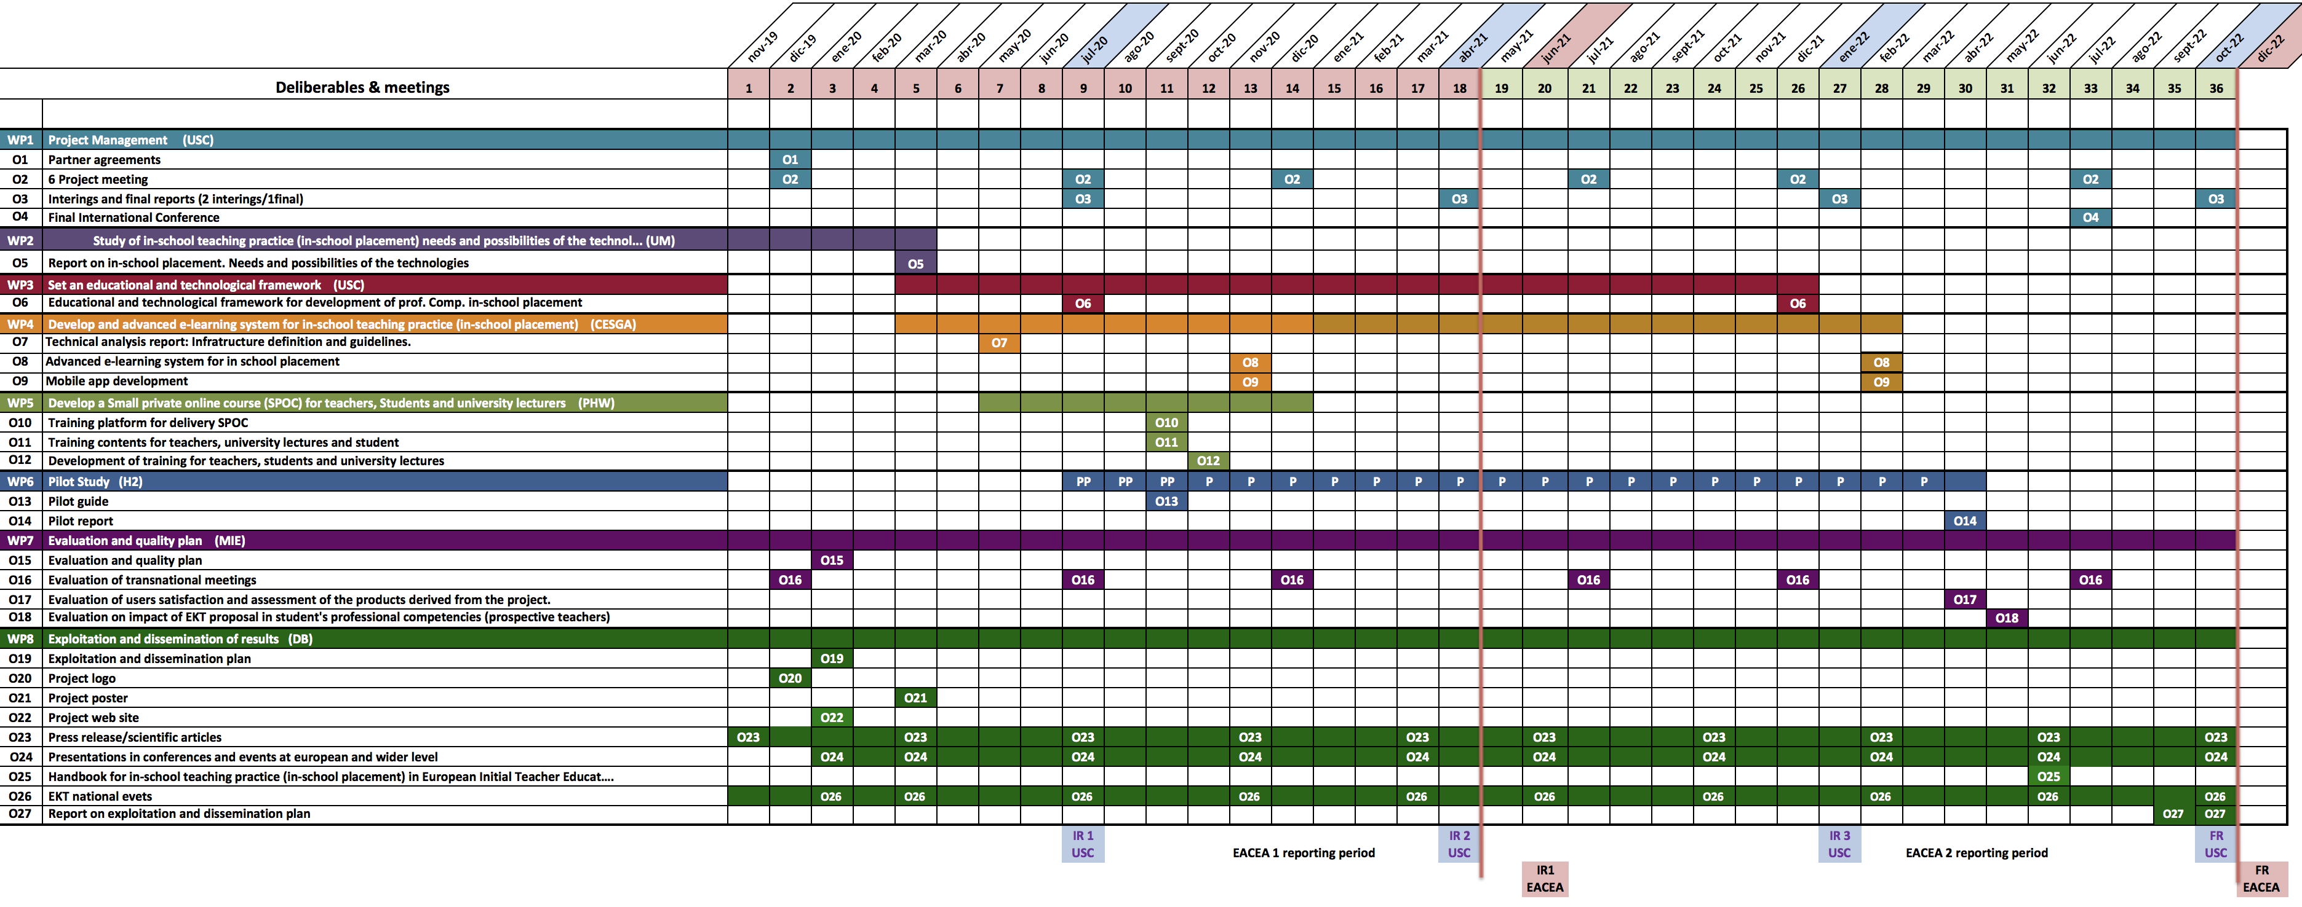
EKT: Schedule and work sequence
Notes:
To finish a quick overview of the sequence and timing:
Eligibility period 01-11-2019 to 31-10-2022
Two reporting periods to the Agency month one to eigteen 18 mont nineteen to thirty six
four internal partner reports to the USC: month 9, 18 and month 27 (interim reports 1, 2 and 3) Month 36 (final report6). Specified in the contract.

Slide 19
EKT: Questions and doubts?
Thanks for your attention
Carmen Fernández Morante
carmen.morante@usc.es

